Slide 1
Summer training
OBJECT ORIENTED PROGRAMMING USING C++

Slide 2
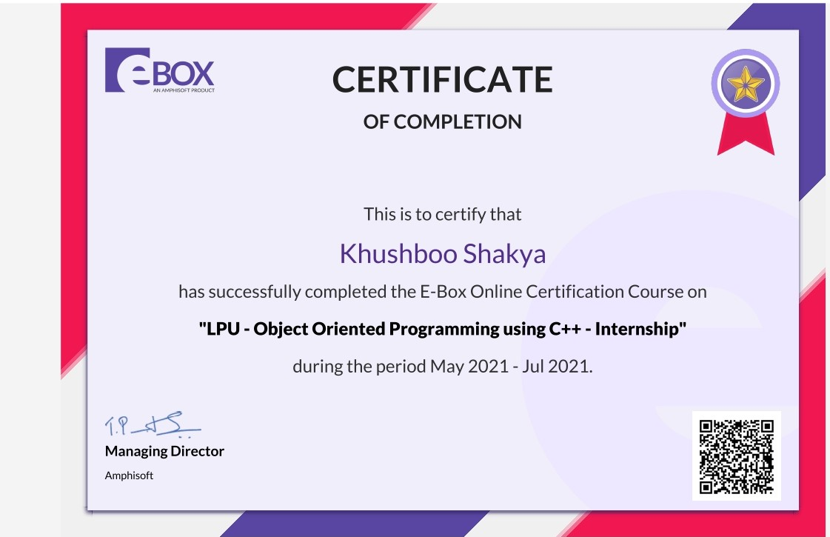
Certificate

Slide 3
Experience
Learned OOPs Concepts.
Solved lots of real life problem.
Hands-on projects.

Slide 4
Learned skills
To understand how C++ improves C with object-oriented features.
To learn how to write inline functions for efficiency and performance.
To learn the syntax and semantics of the C++ programming language.
To learn how to design C++ classes for code reuse.
To learn how to implement copy constructors and class member functions.
To understand the concept of data abstraction and encapsulation.
To learn how to overload functions and operators in C++.
To learn how containment and inheritance promote code reuse in C++.
To learn how inheritance and virtual functions implement dynamic binding with polymorphism.
To learn how to design and implement generic classes with C++ templates.
To learn how to use exception handling in C++ programs.

Slide 5
projects
QUIZ SYSTEM

Slide 6
project
What is Quiz System?
Quiz System refers to service as conduct online examination or test. It will use for students progress evaluation using modern computer technology. It replaced the paperwork and overcome the outcomes of traditional way of examinations using paper or pen.

Slide 7
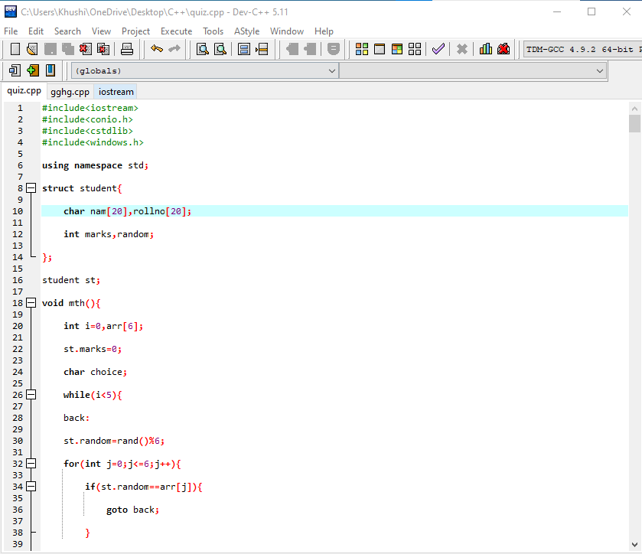
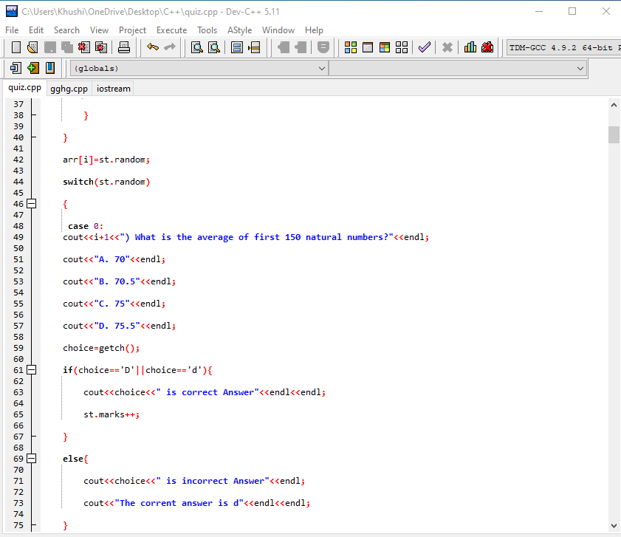
CODE

Slide 8
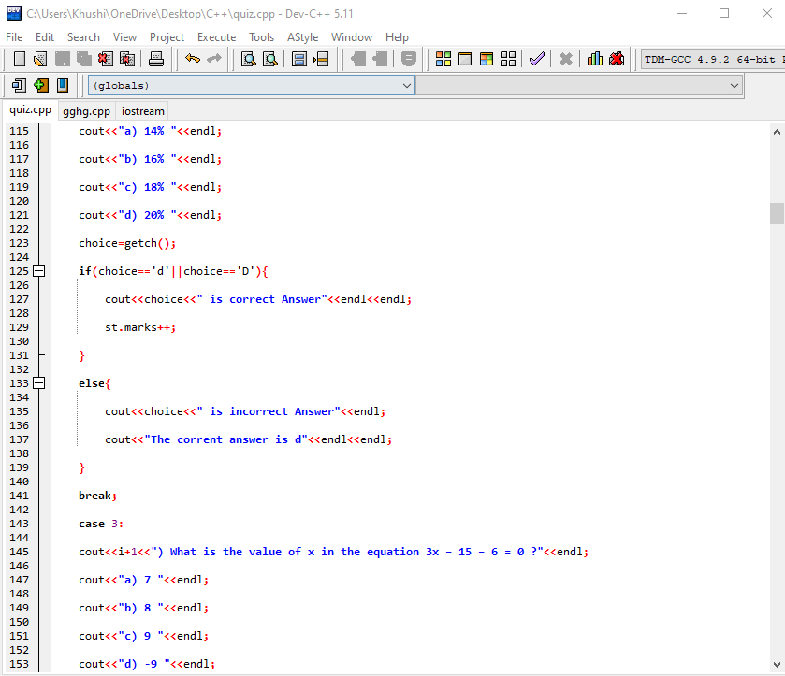
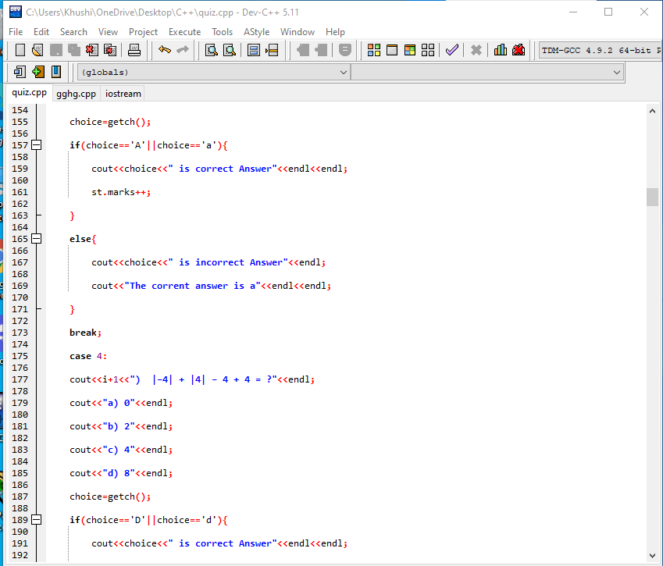

Slide 9
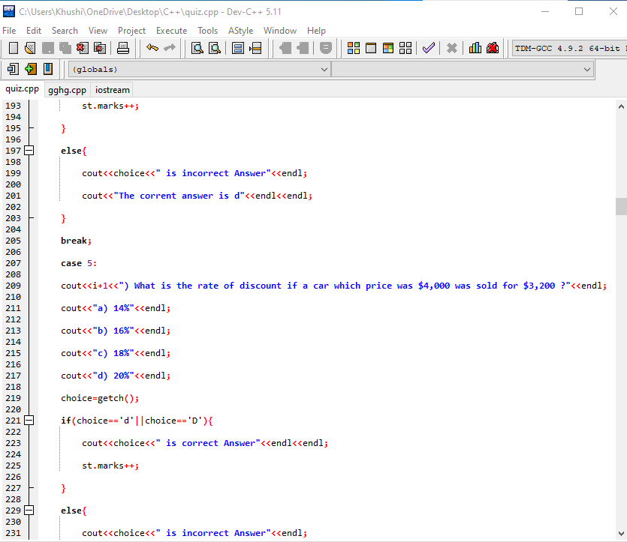
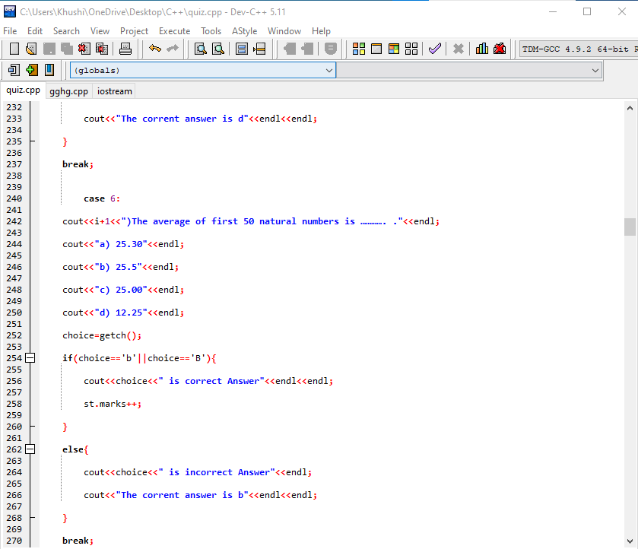

Slide 10
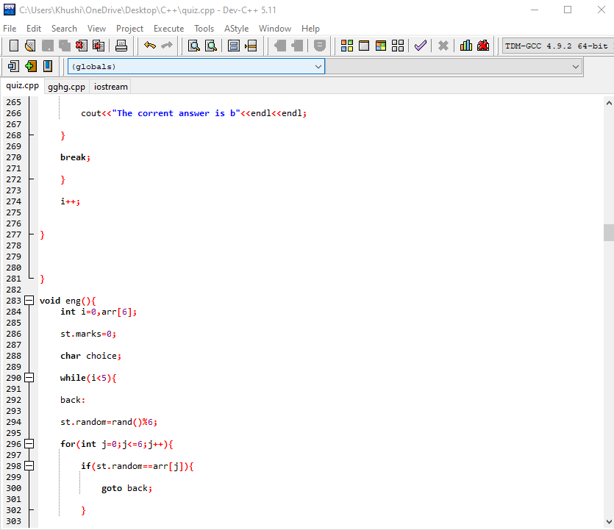
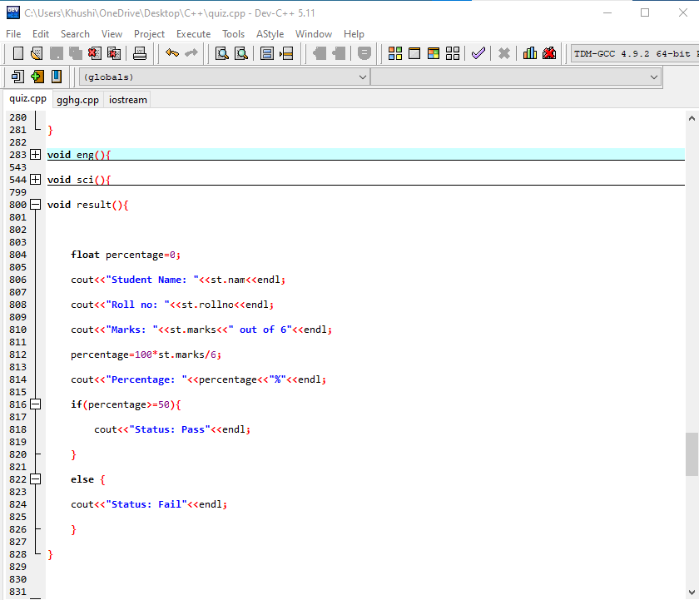

Slide 11
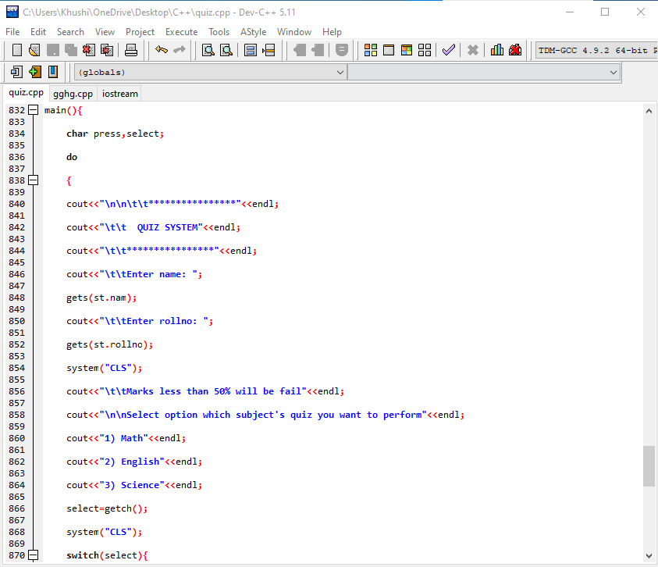
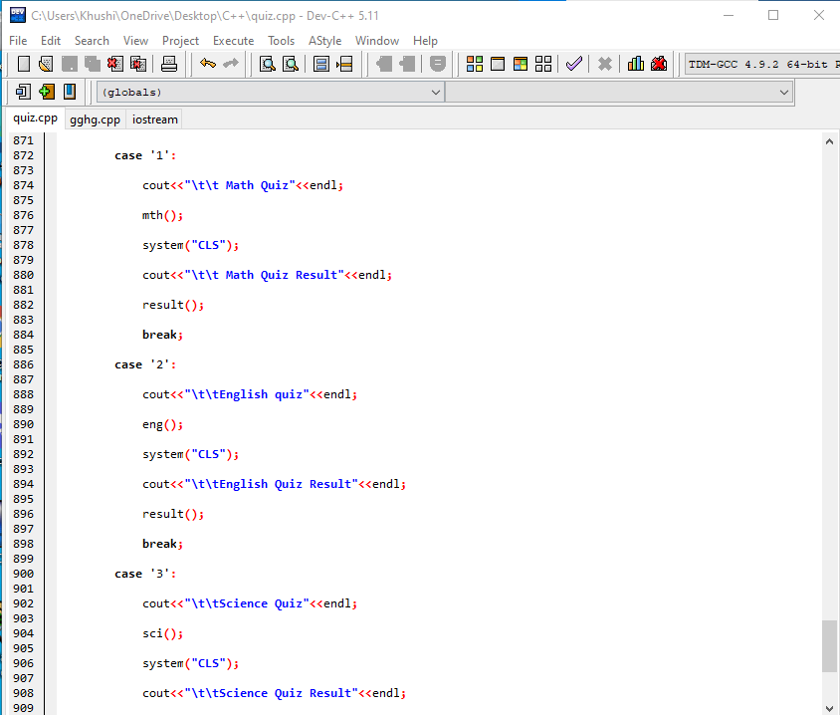

Slide 12
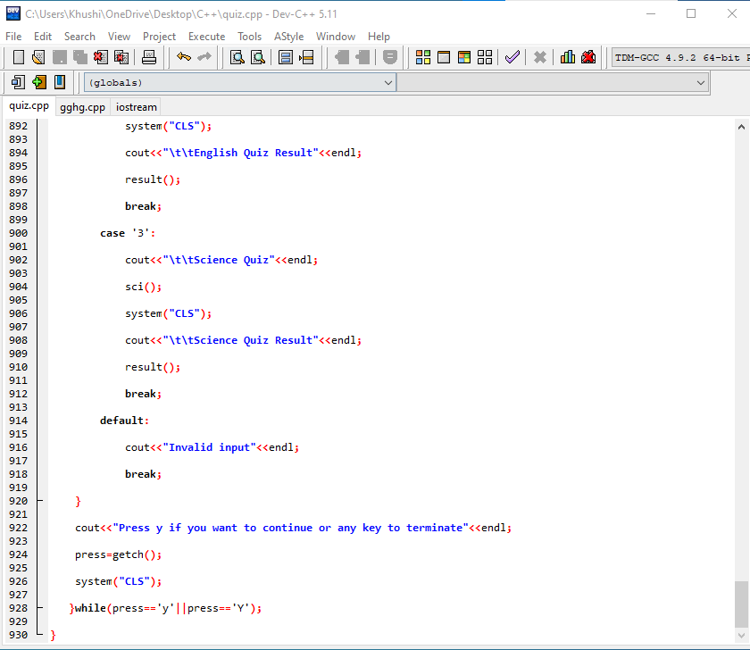

Slide 13
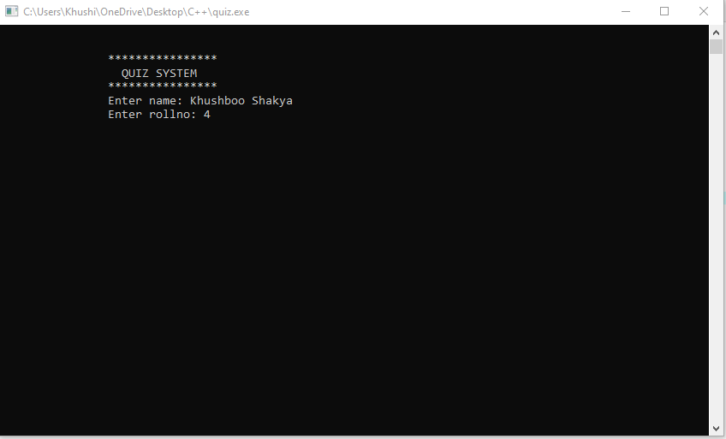

1)Adding user information
In this section we need of the information of the student which likes: Name, Roll Number. After taking these details to the Student

Slide 14
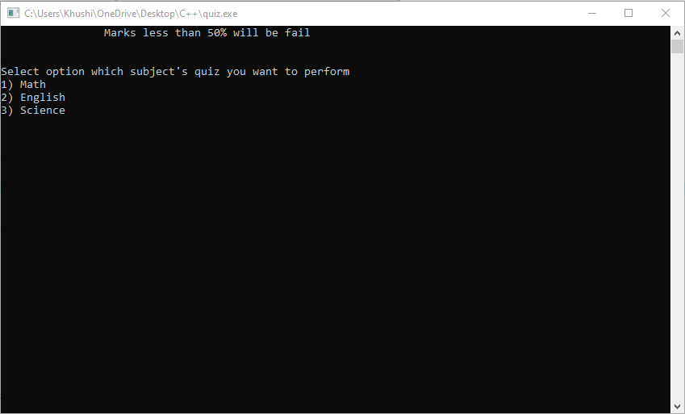
2) SUBJECT SELECTION
We can select subject in which we want to give the quiz after giving user information to quiz system.

Slide 15
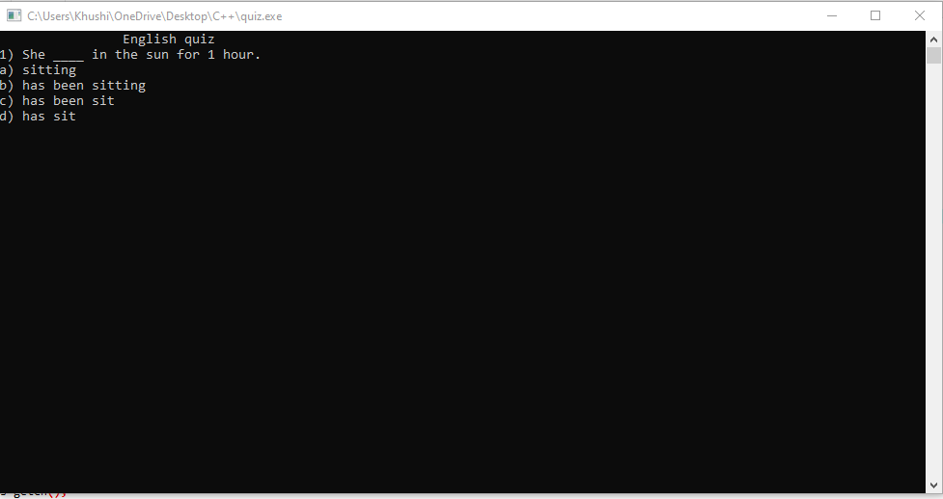
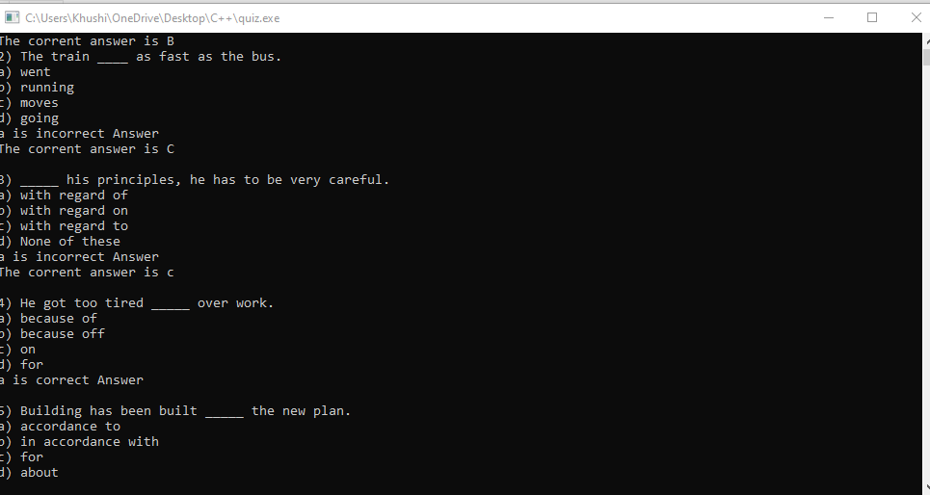
3) MCQ Selection
There will be various kind of MCQ in this section related to the subject you have chosen .

Slide 16
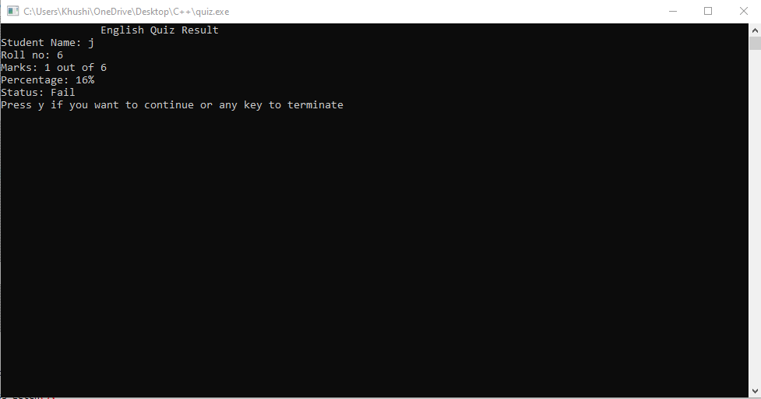
4) Marks calculator and status
With this feature you can calculate the marks and percentage of that subject in which we have given the quiz This feature allows users to see the pass and fail status of the quiz.

Slide 17
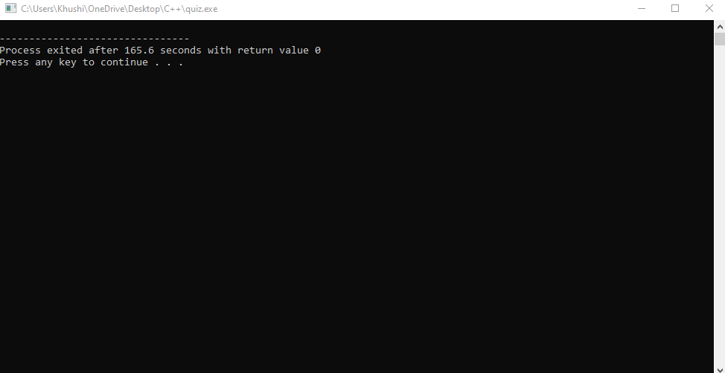
5) EXIt
Its Section specially made for Quitting the Quiz Software the when do we complete with our all the activity then we can easily go out of the software after using this option.

Slide 18
Thank You

